Slide 1
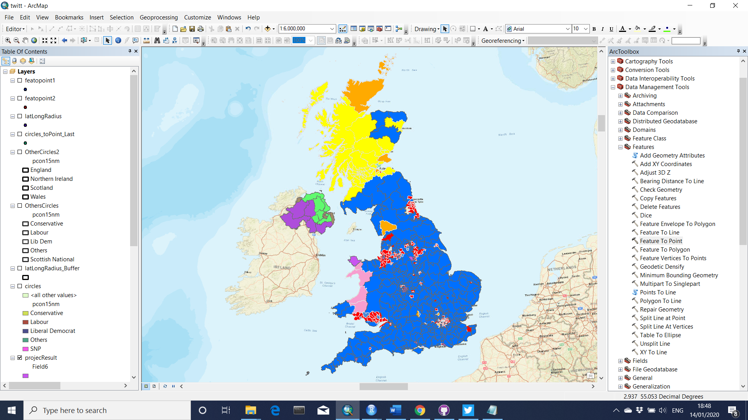
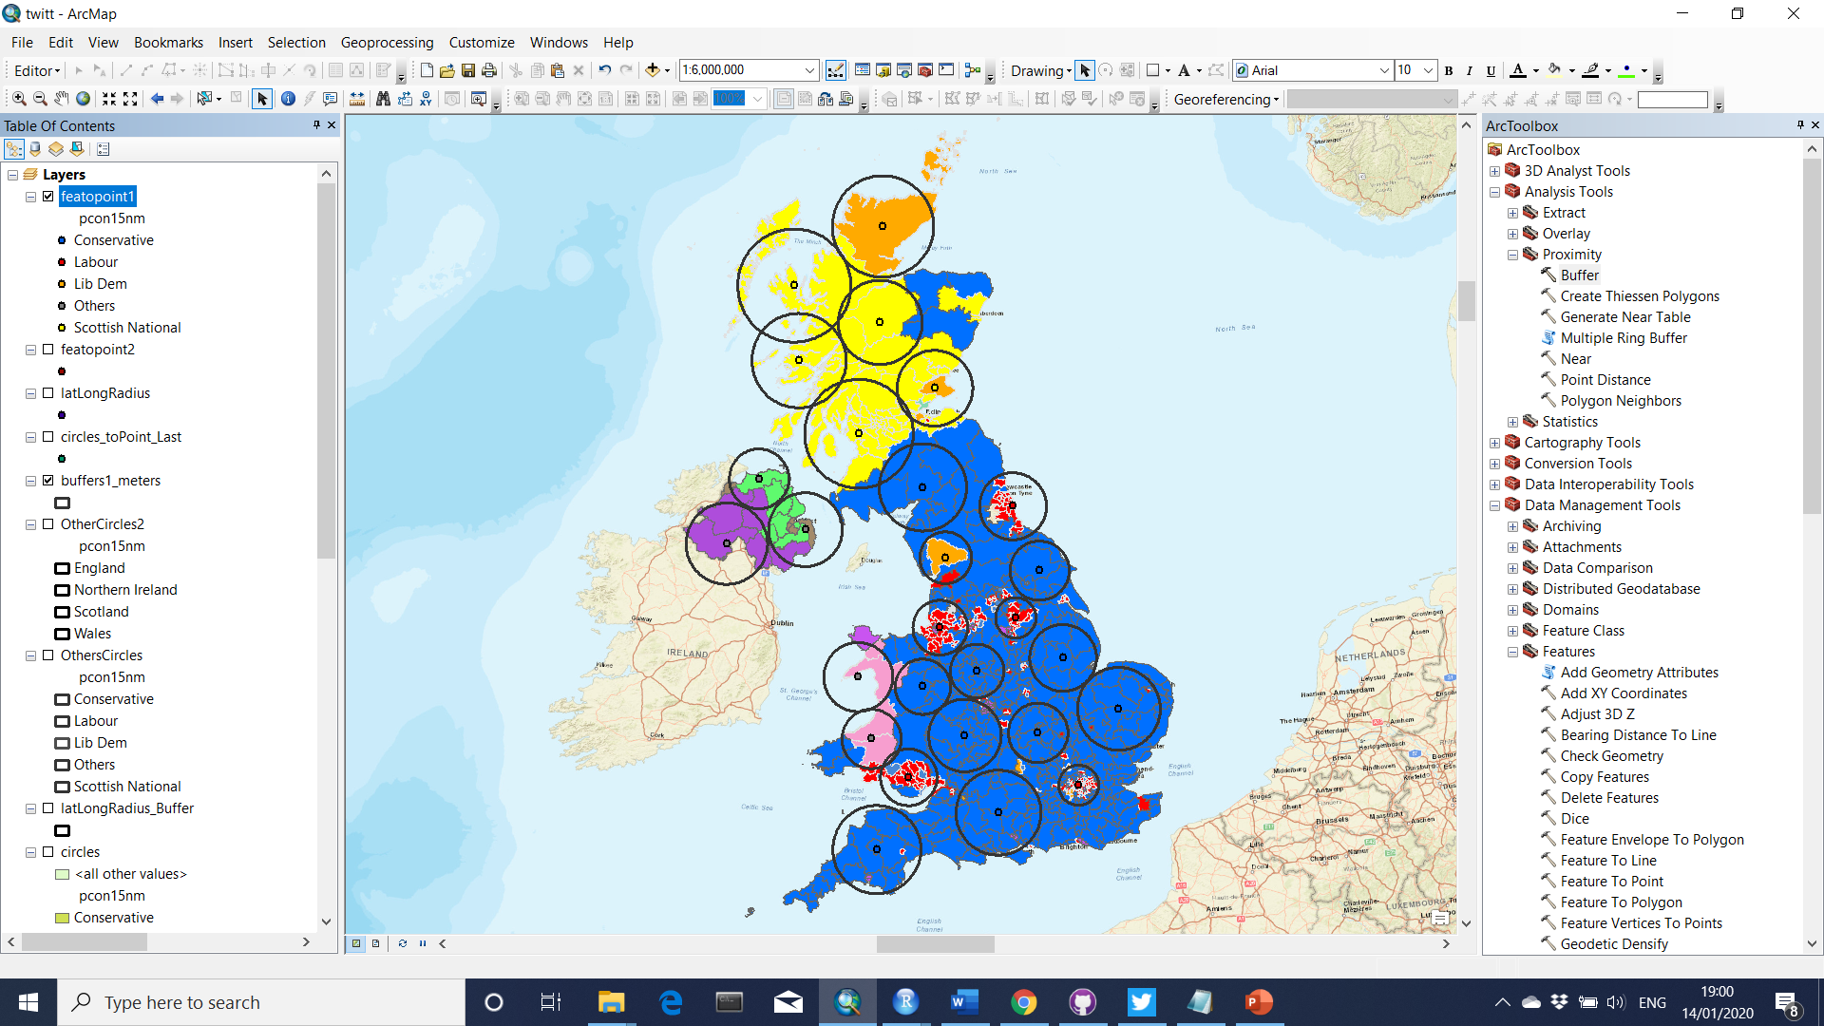
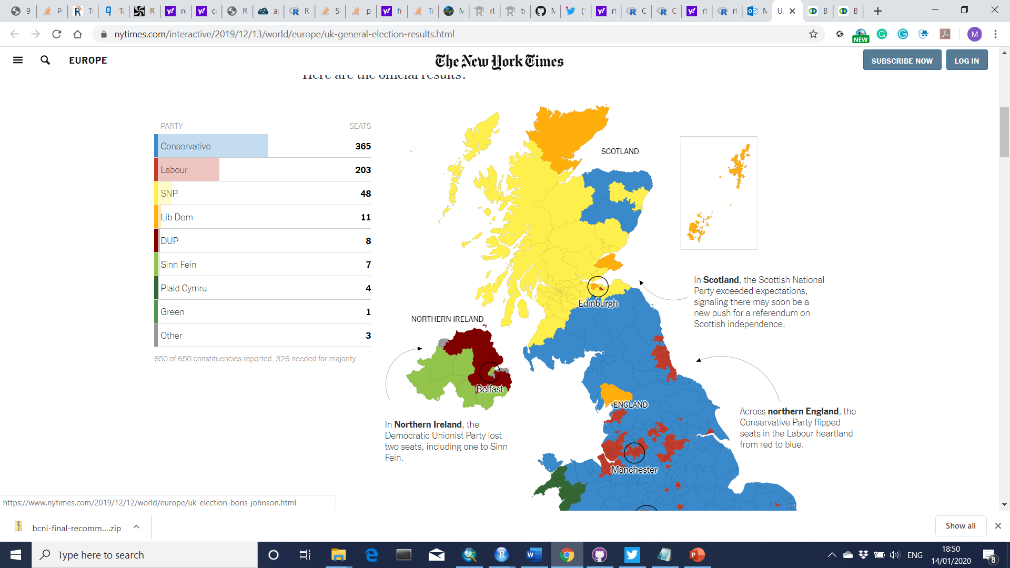
UK 2019 General Election Results
Data collection (by Voting Results)

Slide 2
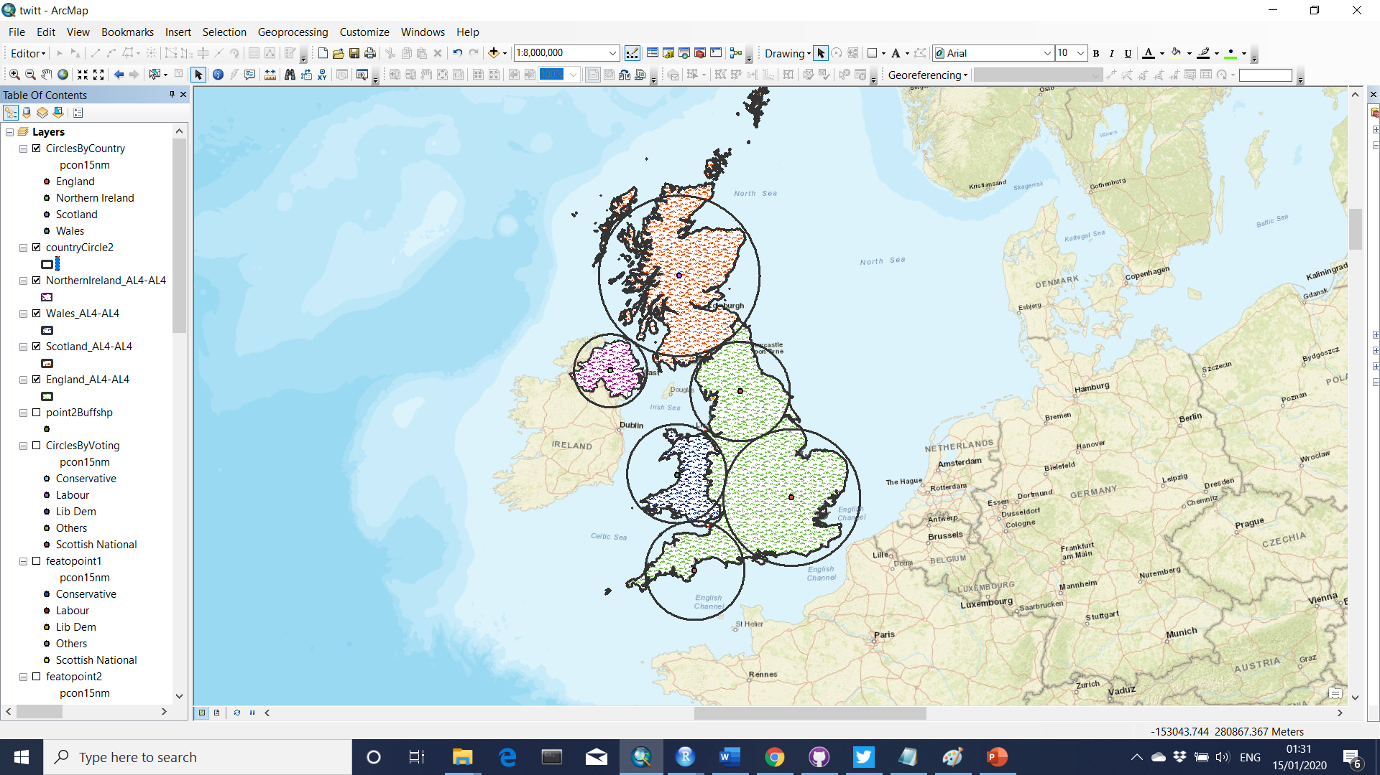
Data collection (by Country)
Data collection (by Voting Results)
England
Wales
North. Ire.
Scotland

Slide 3
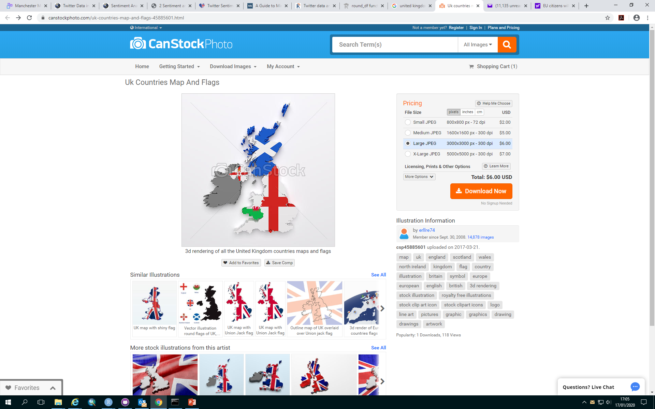

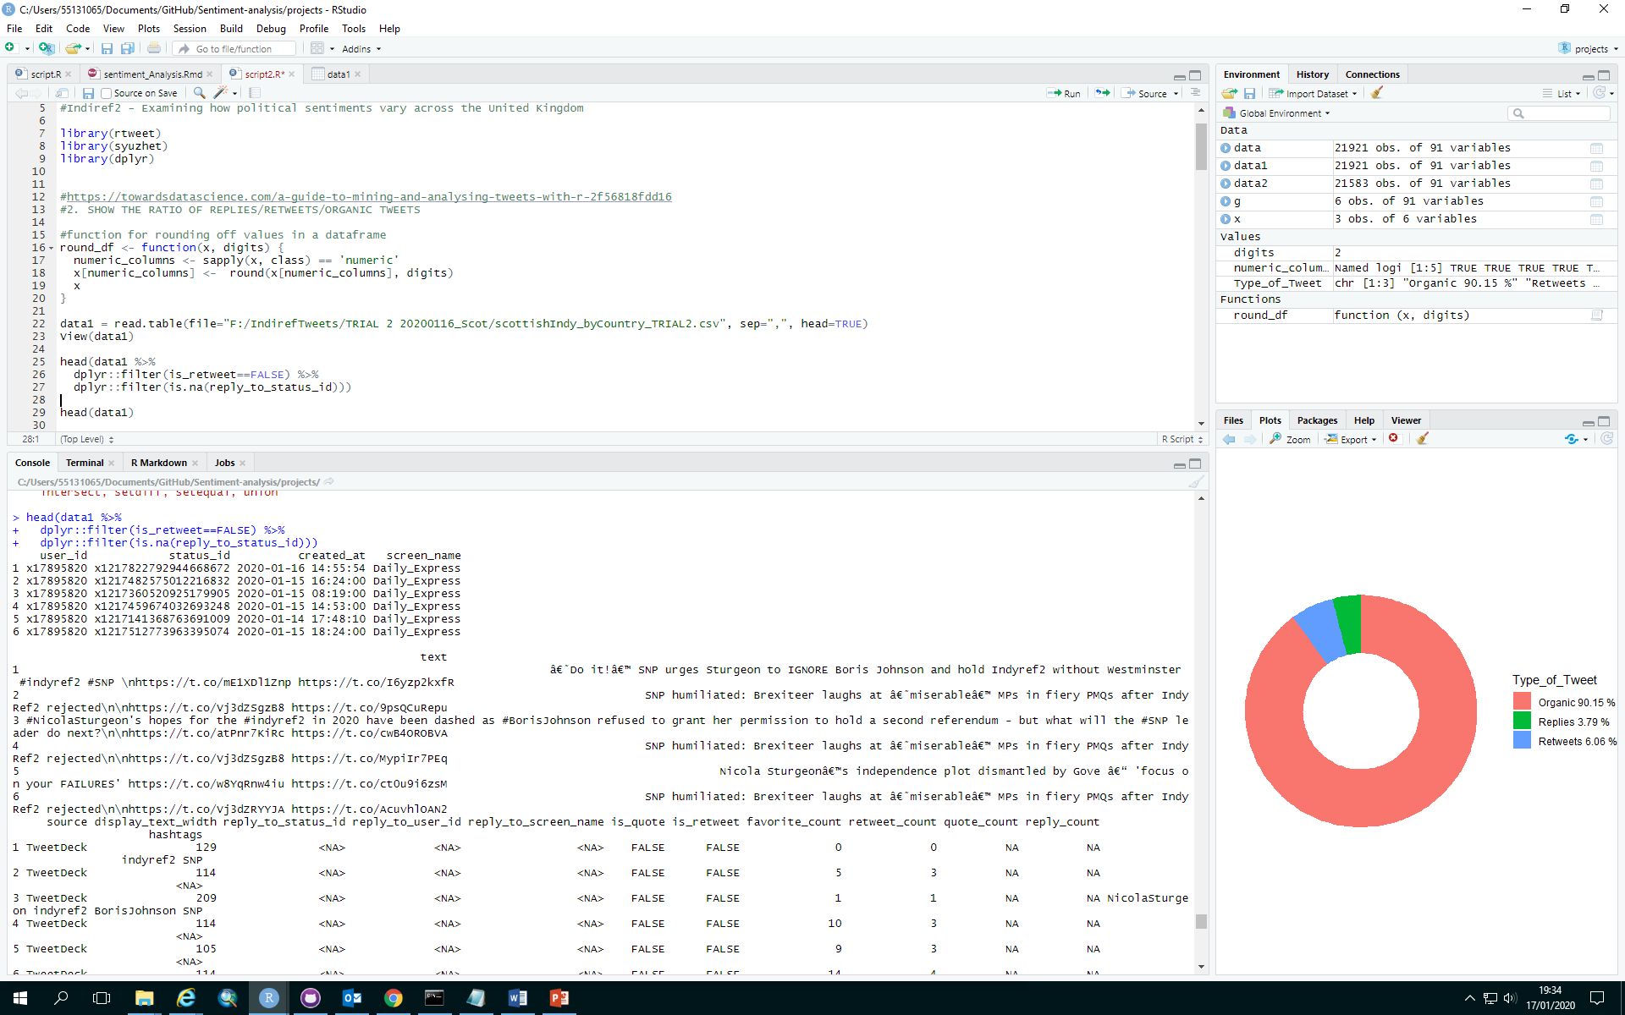

Slide 4
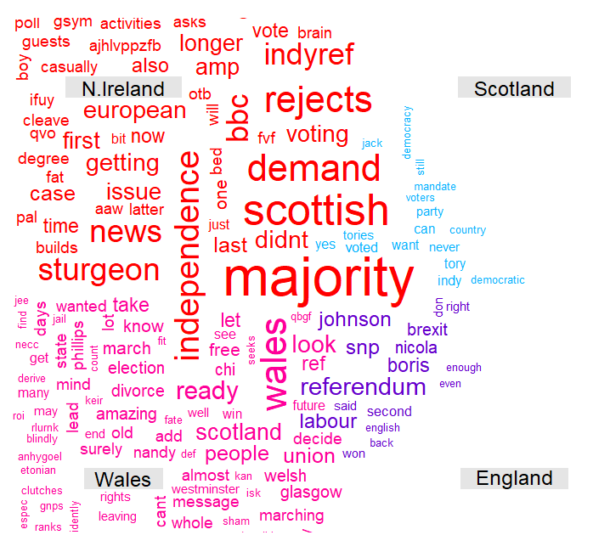
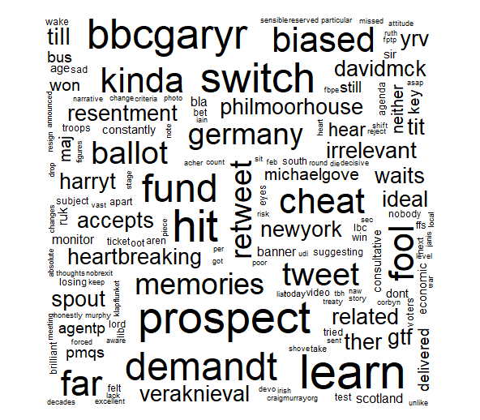

Slide 5
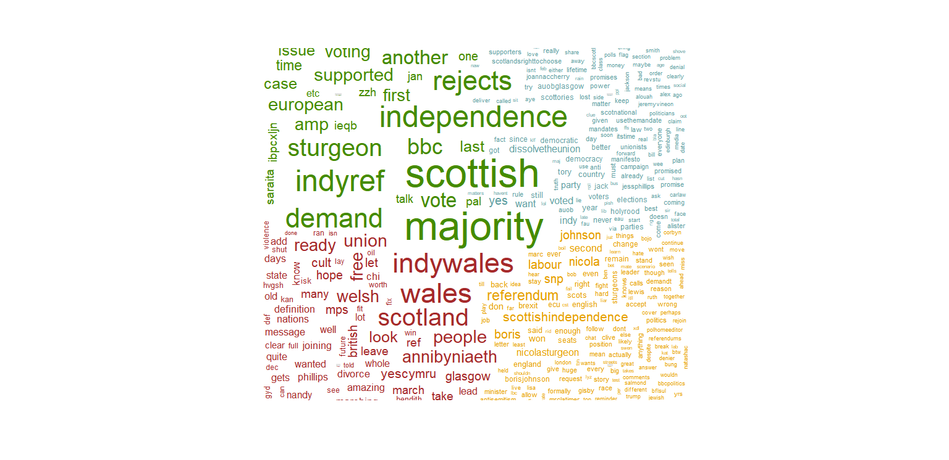
Common Words Frequencies between countries
Differences in Word Frequencies within countries

Slide 6
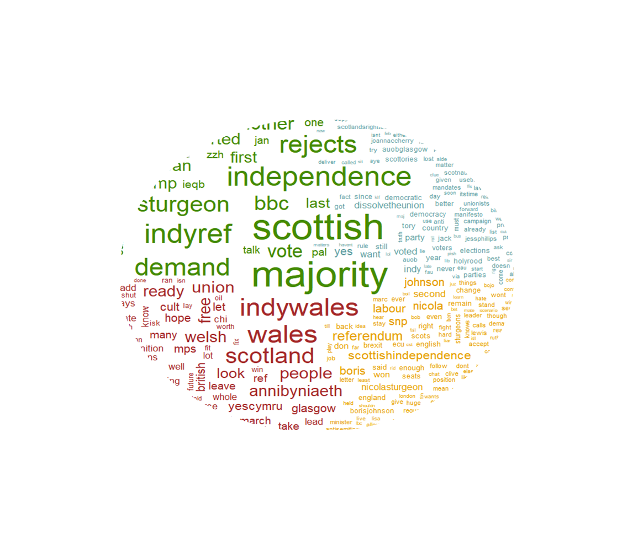
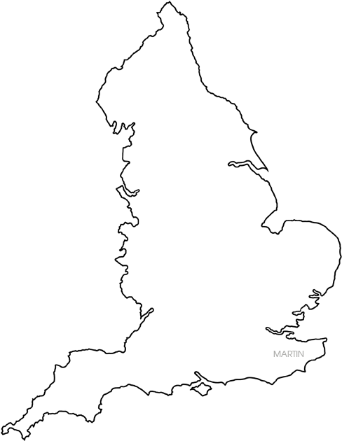
Common Words Frequencies between countries

Slide 7
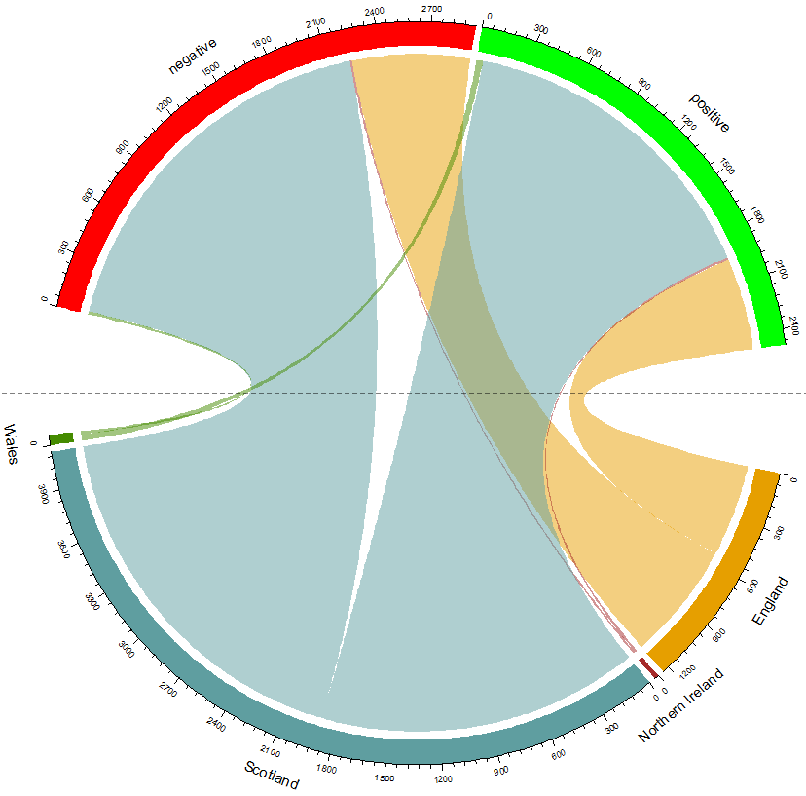
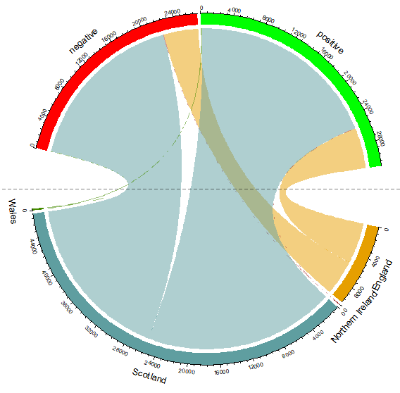
Negative
Polar Sentiment
47%
Positive
53%
47%
47%
Wales
England
Northern Ireland
Scotland

Slide 8
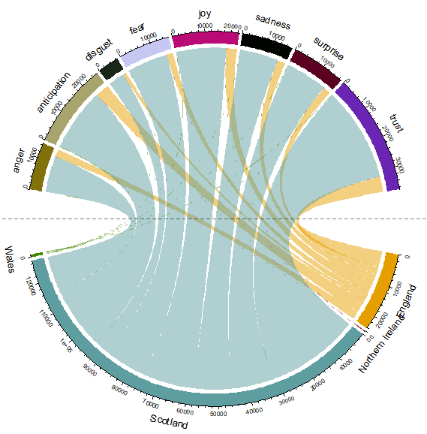
Expanded Sentiment
Joy
Sadness
Fear
Disgust
Surprise
Anticipation
Trust
Anger
Wales
England
Northern Ireland
Scotland

Slide 9
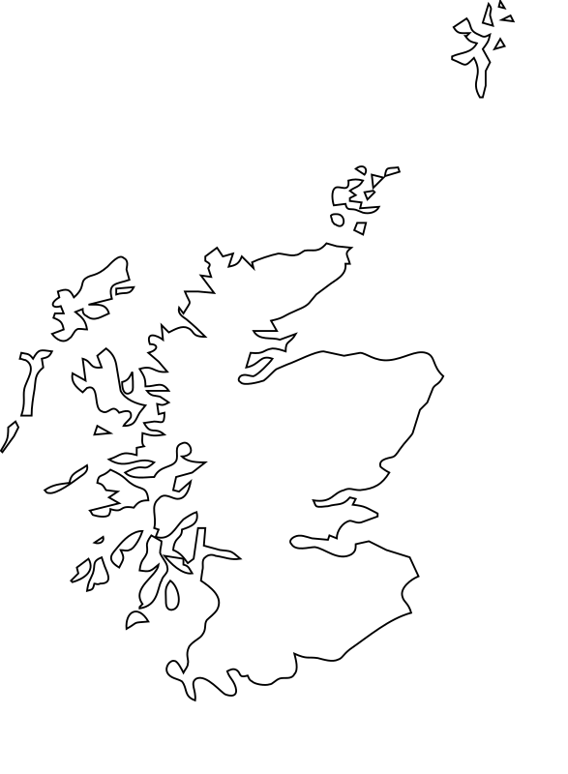
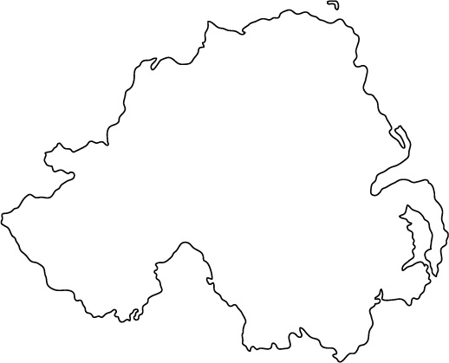
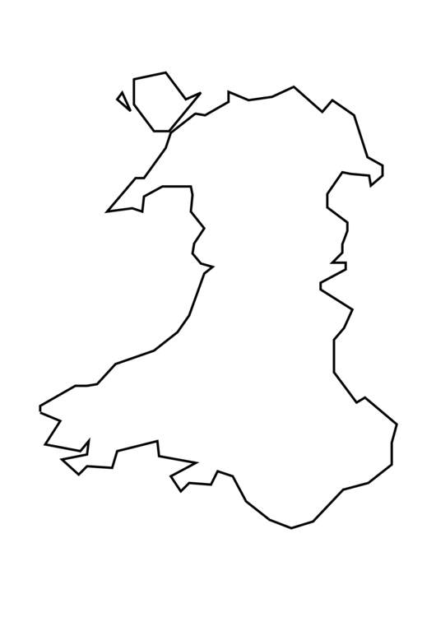
Scotland
Northern Ireland
England
Wales

Slide 10
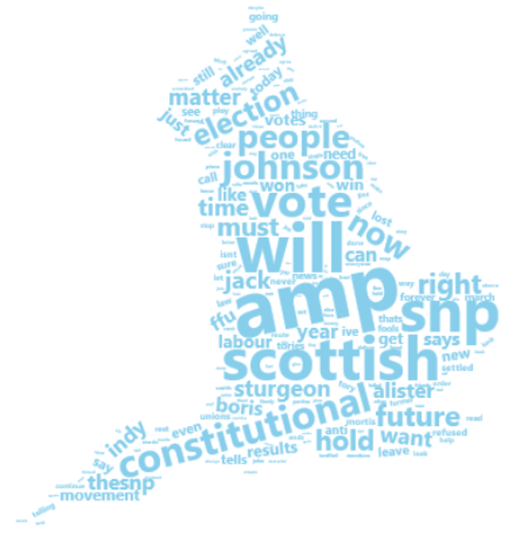
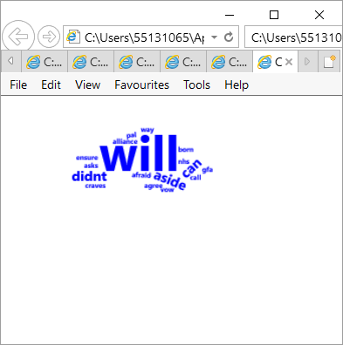
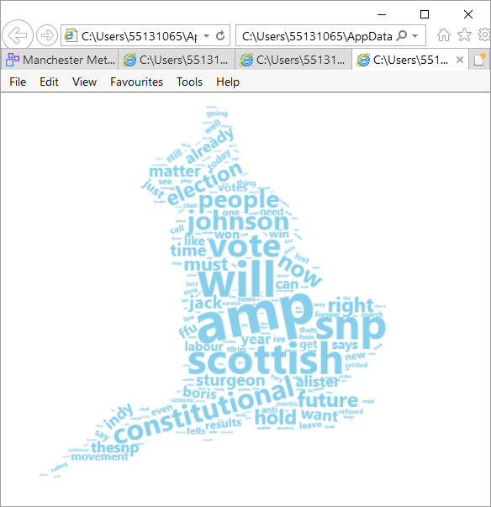
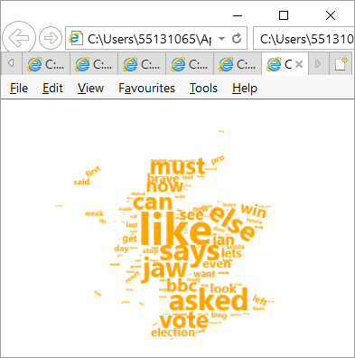
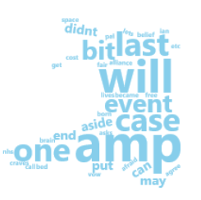
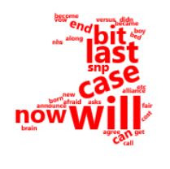
Scotland
Northern Ireland
Wales
England

Slide 11
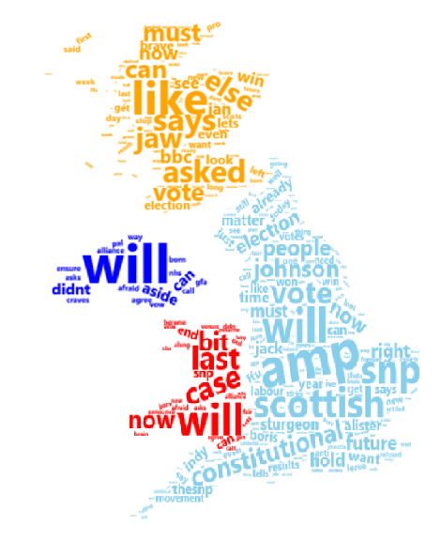
England
Wales
Northern Ireland
Scotland
Proportion of tweets
Importance of words
Northern Ireland
Wales
Scotland

Slide 12
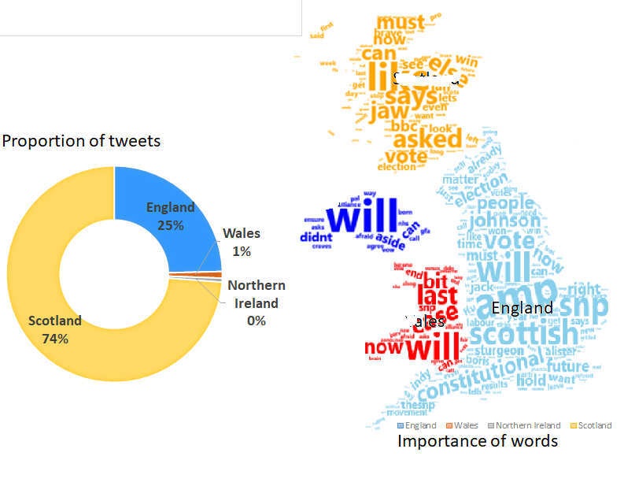
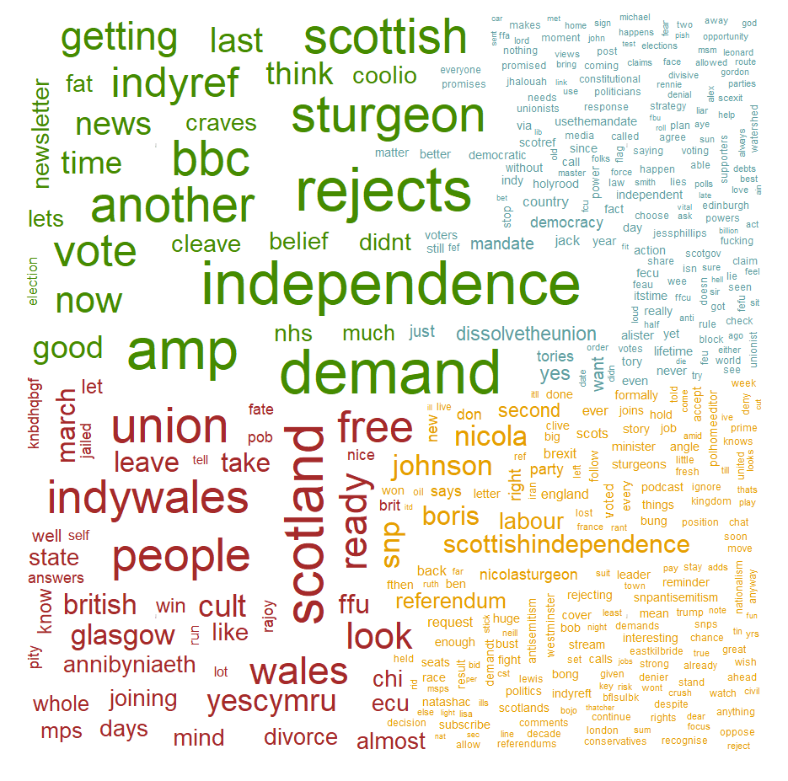
Density of subjects
Indicate the richness of the discussions
Names of politicians
Issues
indywales

Slide 13
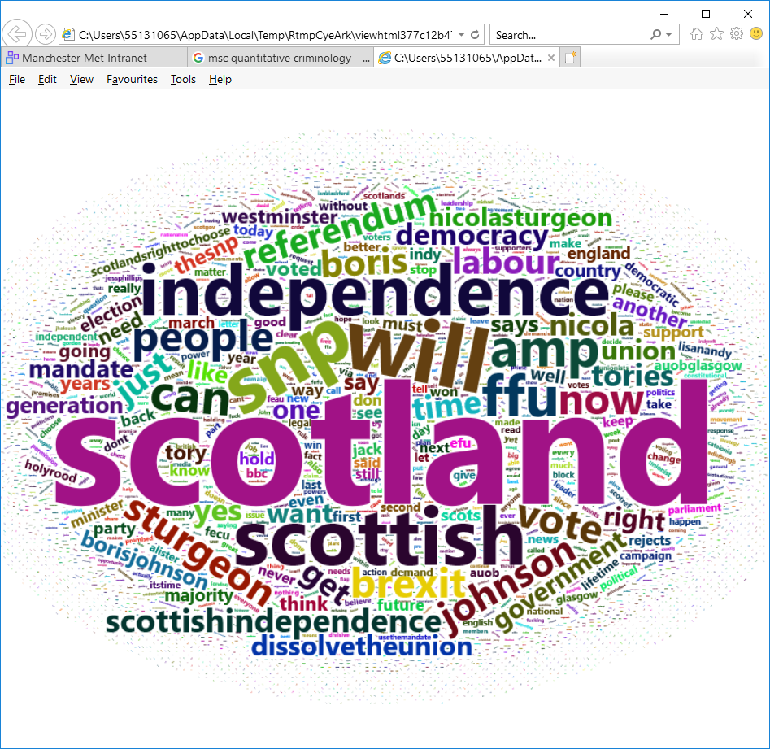
England

Slide 14
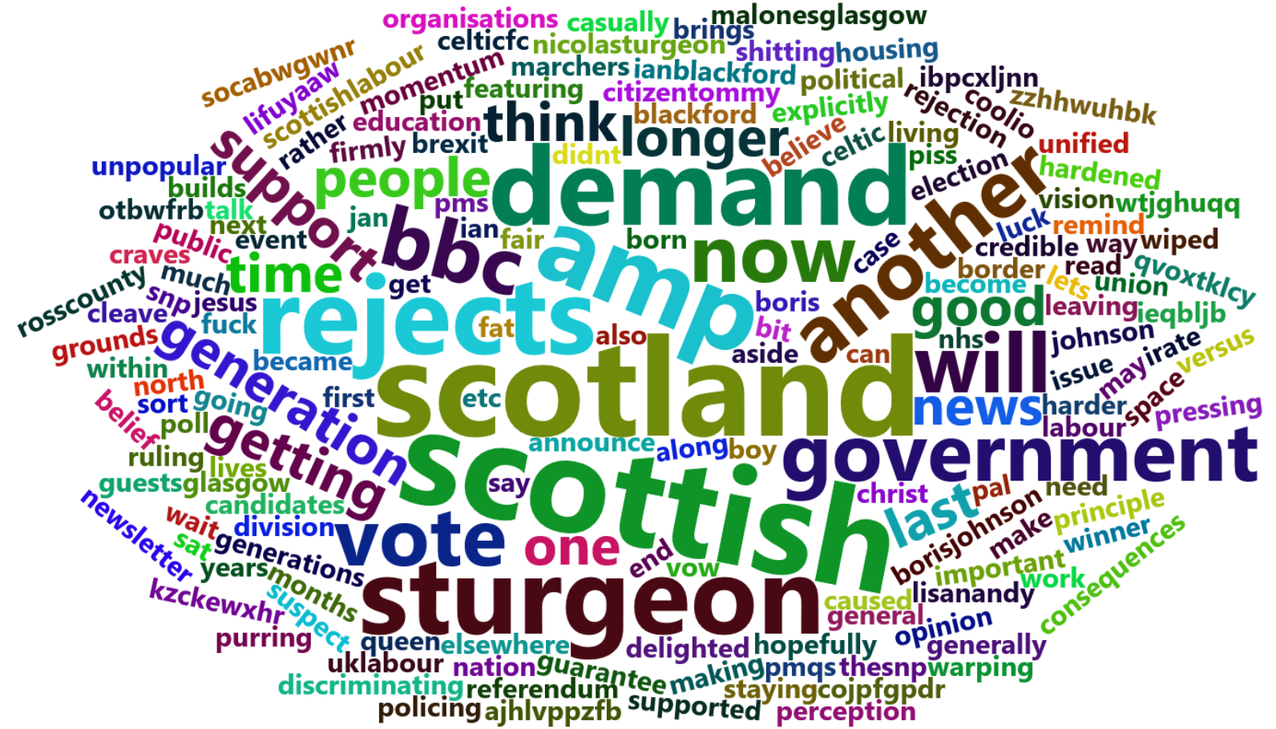
Northern Ireland

Slide 15
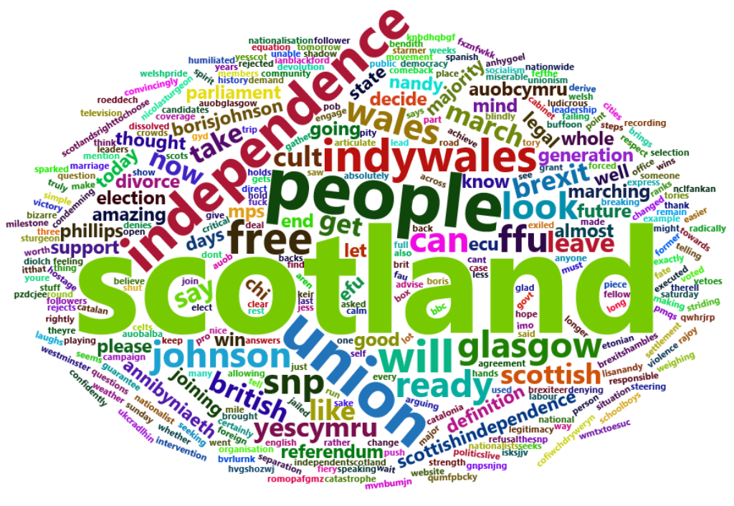
Wales

Slide 16
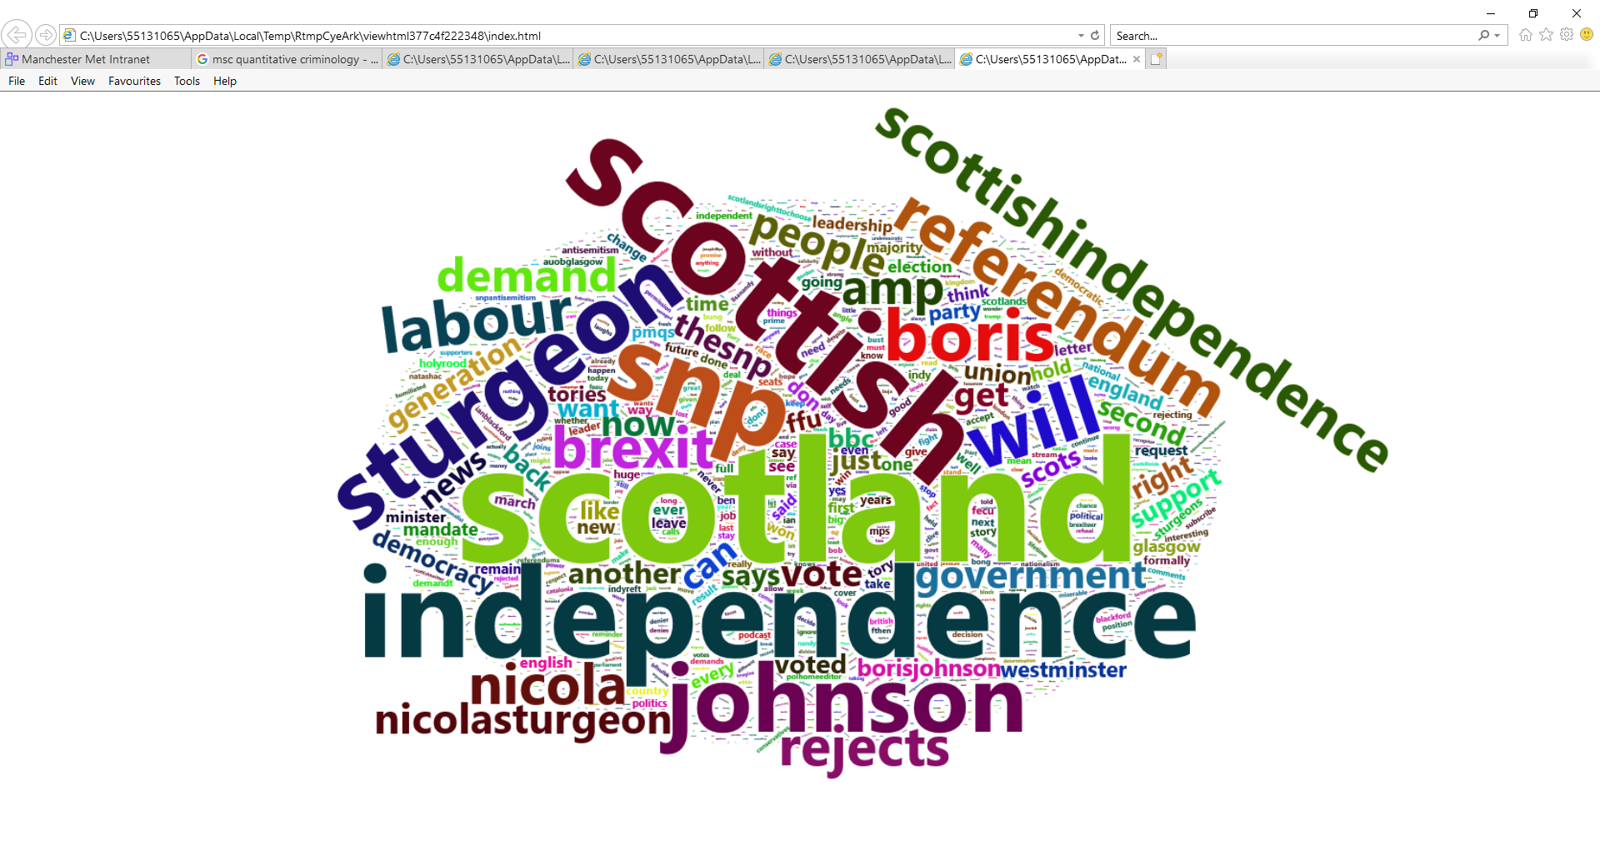
Scotland

Slide 17
Northern Ireland
Scotland
Wales
England
Importance of words used in tweets

Slide 18
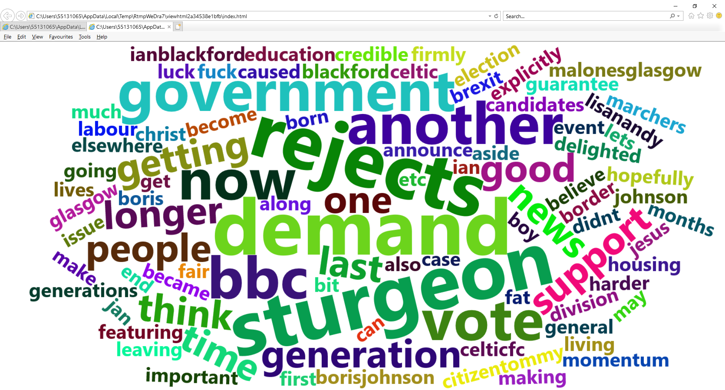
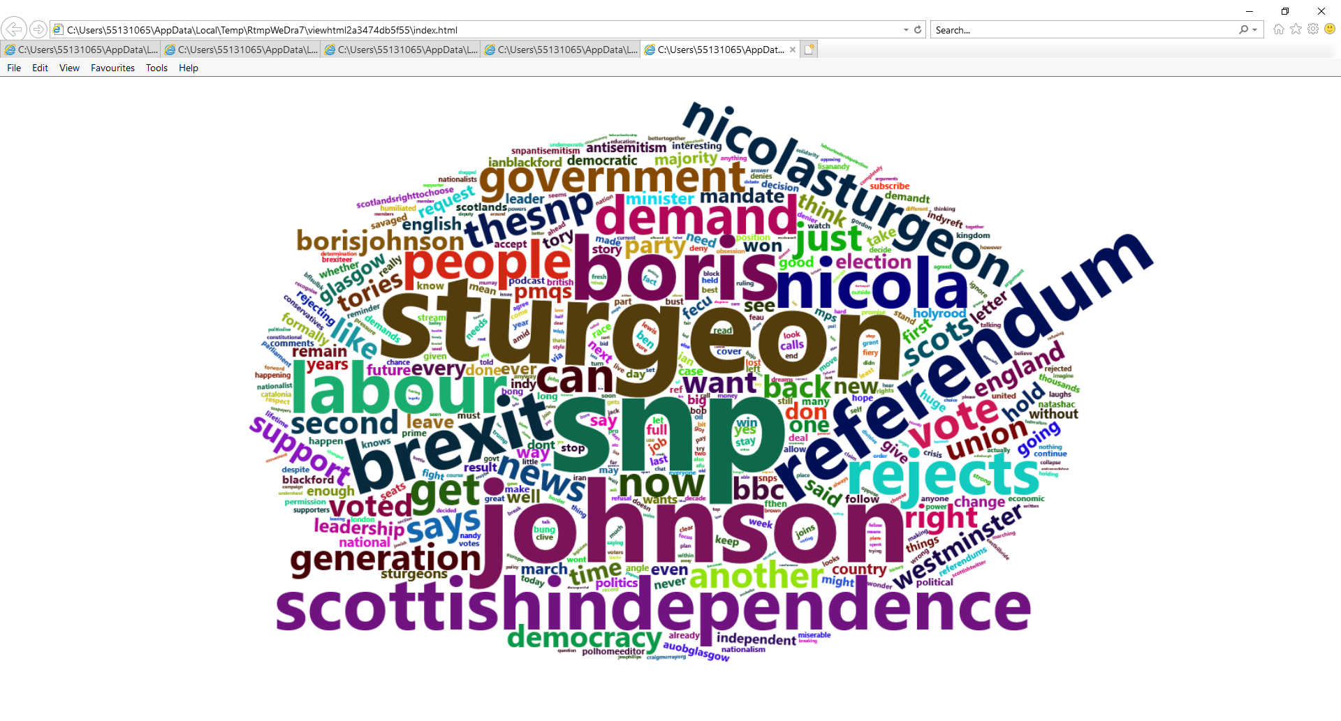
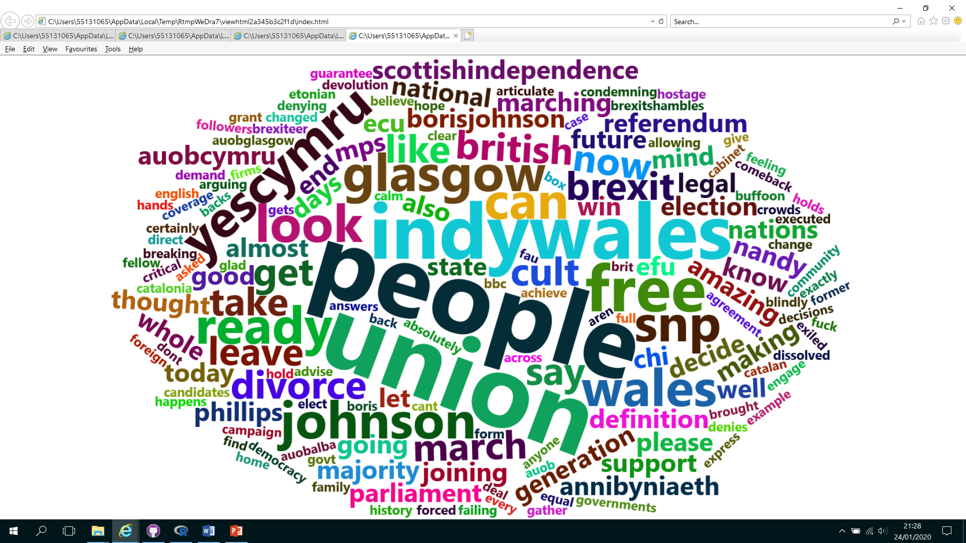
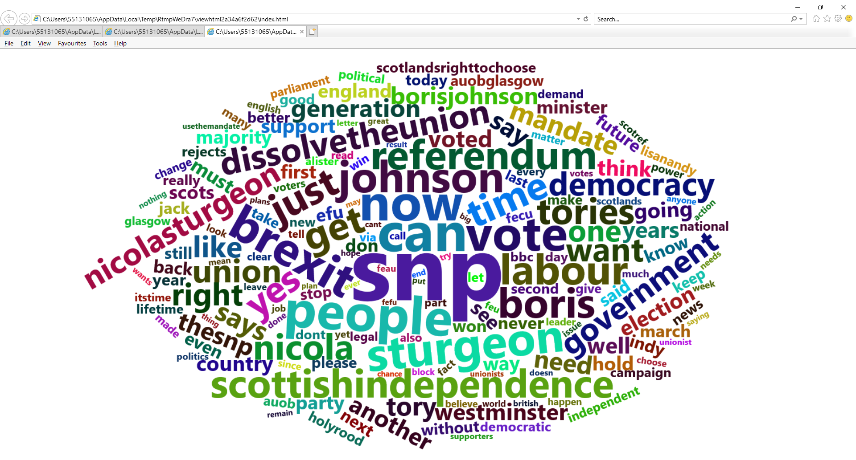
Northern Ireland
Scotland
Wales
England
Importance of words used in tweets

Slide 19
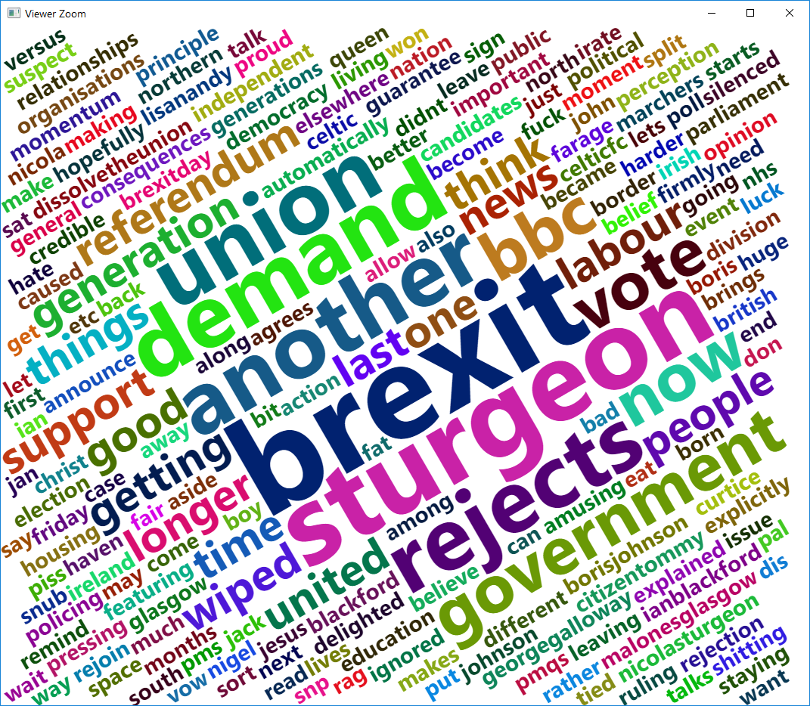
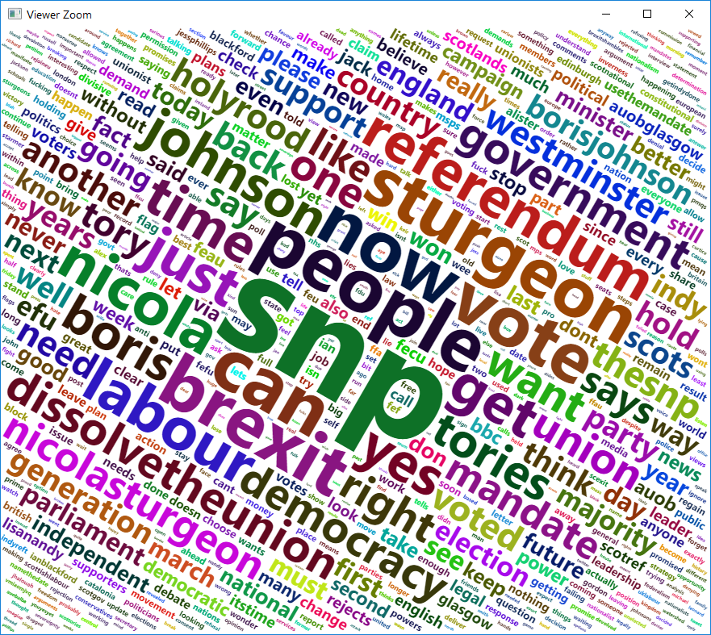
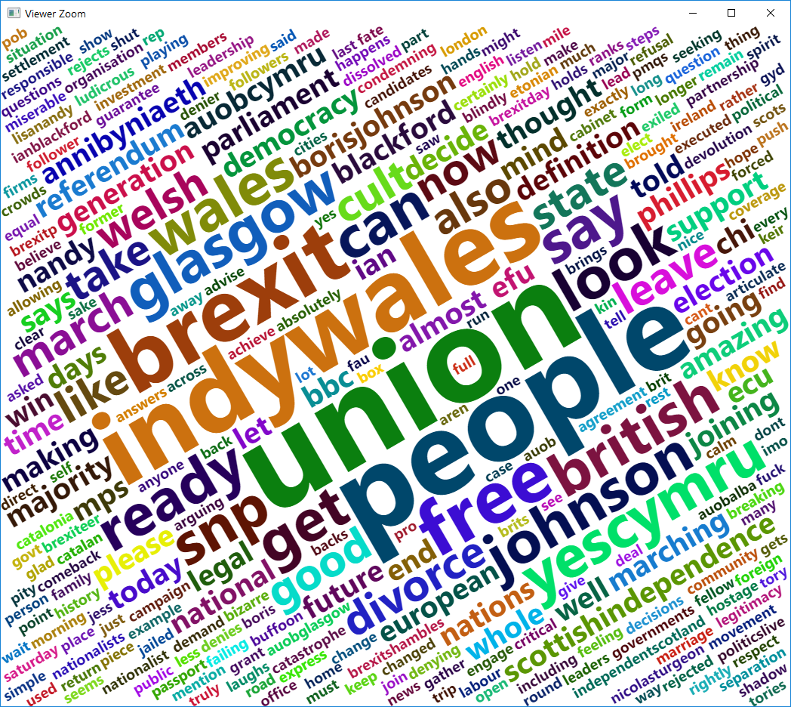
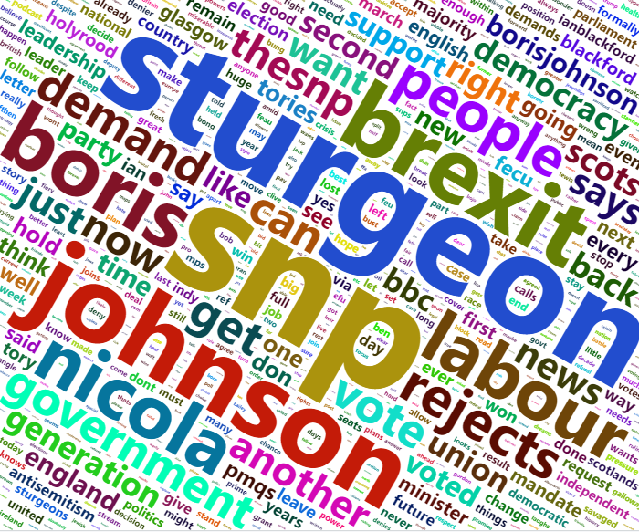
Northern Ireland
Scotland
Wales
England
Importance of words used in tweets

Slide 20
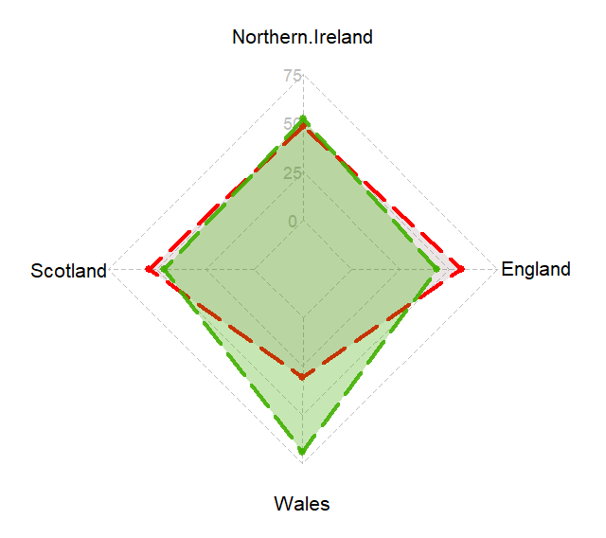
Positive
Negative
Importance of words used in tweets

Slide 21
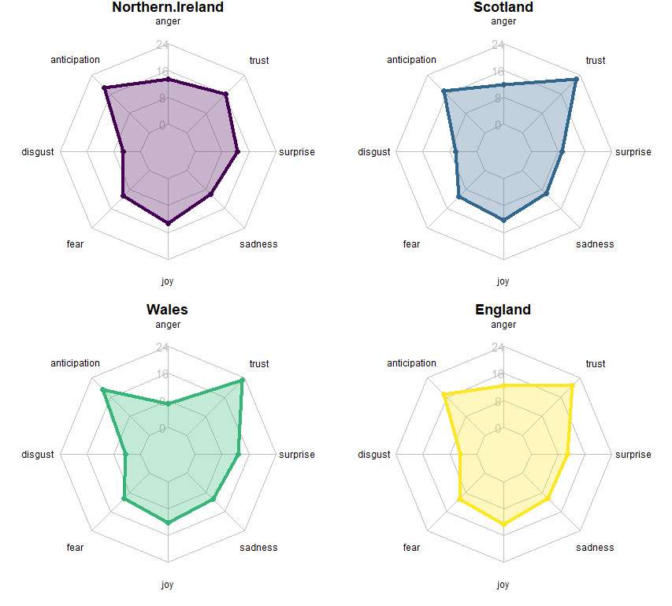
Importance of words used in tweets

Slide 22
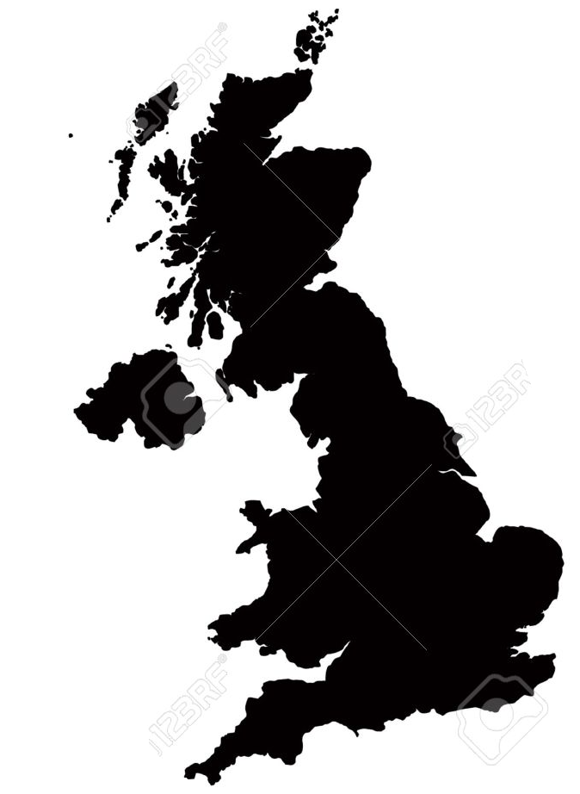
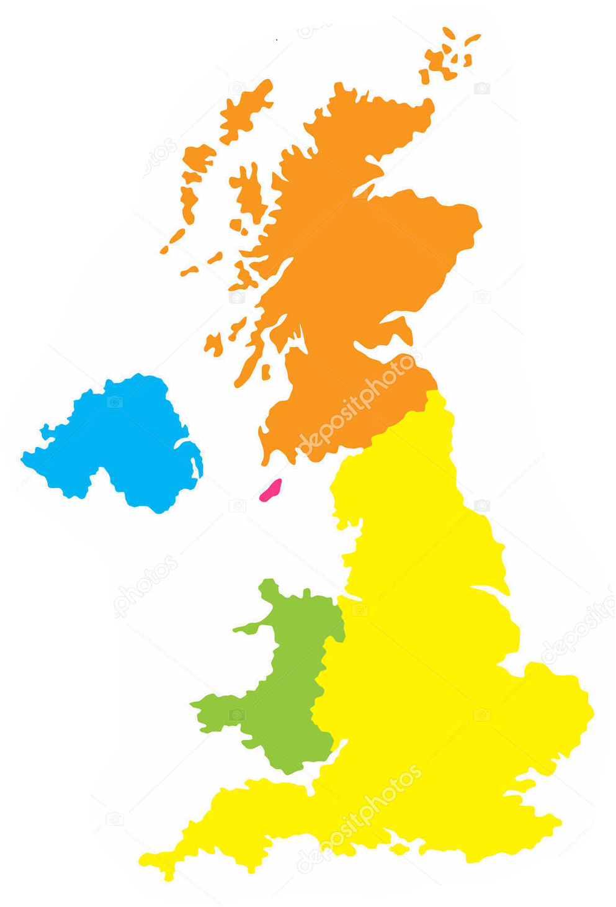
Scotland
Northern Ireland
Wales
England

